Slide 1
CSC 101 : Introduction to Computer Science
WEEK 3
Notes:
1

Slide 2
The System (Mother) Board
contained within the CPU
all vital computer part are plugged directly to the system board.
Other items such as the hard disk are attached to the system board, either directly or via cables. These boards are getting smaller and smaller as the components become more integrated

Slide 3
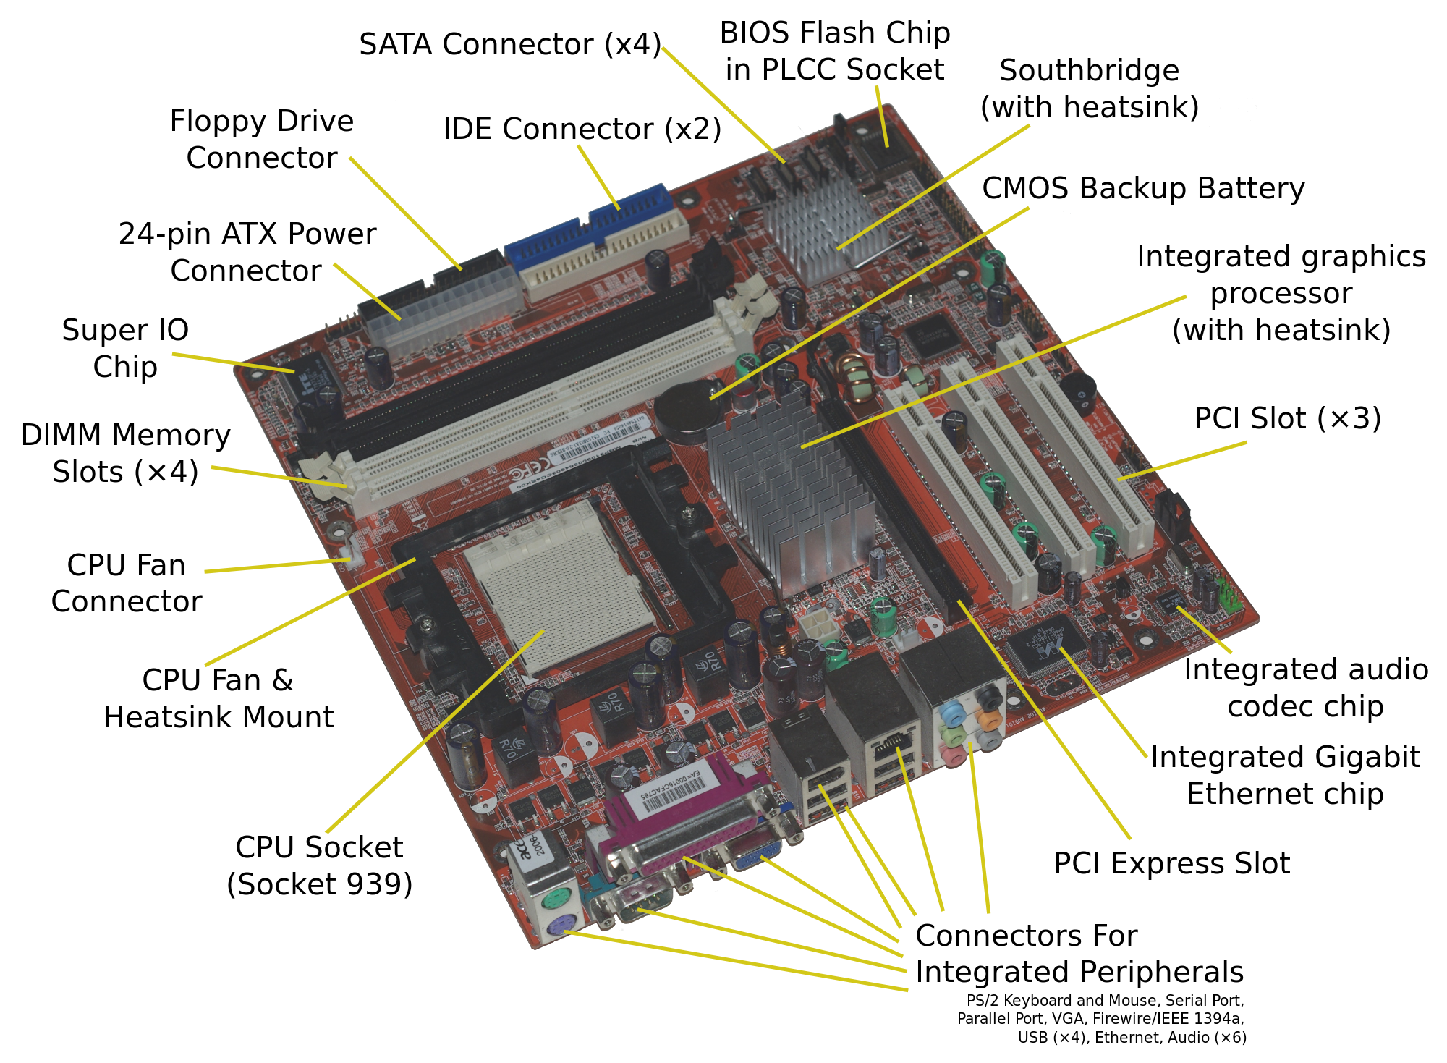

Slide 4
Main Memory
The main memory is also called Internal storage or primary storage/memory. The Internal memory of a computer is an integral element of the processing unit and may be referred to as the computer’s working memory. It is used for storing software in the form of operating system, application programs and utility routines, etc.
Internal storage has to be complimented by external storage, that is, storage external to the processor, which is referred to as “BANKING STORAGE”. This is used for mass storage whereas internal storage is used for immediate access requirements.

Slide 5
The Control Unit
coordinates and supervises all activities within CPU.
(i) Receives instructions from the input unit and decode the instruction.
Fetches data from the main memory and generates signals that are required to act on and execute the instruction.
Keeps constant touch with input equipment, coordinates and keeps tracks of the instructions that have been executed.
(iv) It does not partake in the processing function or store data, rather directs the sequence of operations in and outside the CPU.

Slide 6
(iii) The Arithmetic and Logic Unit (ALU)
This is the unit where arithmetic and logical operations are carried out. It perform arithmetic operation such as addition, subtraction, multiplication, division, logical operation (AND, OR, NOT) and relational operations (<, >, <=, >=, =, <>).

Slide 7
Random Access Memory (RAM)
main 'working' memory used by the computer
modern computer can effectively house as much RAM as you can afford to buy.
modern computers are supplied with over 128 MB of RAM.
a Microsoft Windows based computer will operate faster if you install higher size RAM
Data and programs stored in RAM are volatile (i.e. The information is lost when you switch off the computer).

Slide 8
(3) STORAGE UNIT
Read only Memory (ROM)
This unit is also known as Secondary storage, Auxiliary storage, Backing storage or External storage. Data coming to the computer are received by the memory and passed to a permanent storage device. This memory is used to store data not currently being operated on but which will be transferred to the main storage when required. Secondary storage is non-volatile and retains data even when the computer is turned off. There are many kinds of secondary storage; the most common ones are magnetic tape, magnetic disk and compact disk.

Slide 9
Difference between ROM and RAM
 | Primary (RAM) | Secondary (ROM)
1 | Primary storage/memory is also called Internal or main storage | Secondary storage or memory is also called External or auxiliary storage
2 | It has high speed | It has low speed low
3 | It is very expensive | It is not expensive
4 | It holds data or programs temporary | It holds data or programs permanently
5 | It holds programs and data in current use in CPU | It holds program or data that will still be used in primary storage
6 | It is faster | It is not fast (as primary)
7 | It holds less data | It holds large volume of data or files

Slide 10
(4) OUTPUT UNIT
An output unit is a medium which a computer uses to produce out processed or computed results for users in readable form. Results are either soft copy or hard copy type. A software copy output is the result displayed on the monitor while hardcopy is the output printed on paper.
Output devices on the other hand, decode the data into information. Examples are:
Monitors
Printers
Plotters
Computer Output Microfilm (COM)
Voice Output

Slide 11
COMPUTER SOFTWARE
Software can be defined as the sets of instruction and procedures passed to the computer to perform certain activities or tasks. That is, it is the set of instruction directed to a computer system to perform a specific task. It is often called computer program. It is the program, which direct the operations of computer systems. It is the invisible part of the computer system. Without the software, the computer system is useless.
There are two types of software namely:
System software
Application software

Slide 12
SYSTEM SOFTWARE
System software is sets of one or more programs designed to control and supervise the operation and performance of a computer system. They are the software that acts as interface between the hardware and the user or computer resources. The overall control of the hardware operations and the user self-written programs is done by the system software.
The systems software may be divided into the following:
Operating systems
Utilities and service programs
Translators
Database Management System

Slide 13
Operating System (OS): is a software that manages the resources of the computer. The workings of all hardware components as well as execution of application programs are controlled by the operating systems (OS). Those programs are concerned with the internal control and co-ordination of all aspects of the computer system,
Utilities and service programs: are used for general housekeeping on the computer. They are system programs that provides useful service to the user of the computer by providing facilities for performing common tasks in a routine nature. These tasks are: Formatting a disk, copying of files, sorting, printing, editing, back-up e.t.c

Slide 14
These services include translators for any languages supported by the system and utility programs such as program editors and other aids to programming;
- graphical user interfaces (GUls) providing intuitive, easily learned methods for using microcomputer systems.

Slide 15
APPLICATION SOFTWARE
Application software or program is a computer program designed to help users perform a certain kind of activity. Depending on the task(s) for which it was designed, an application program can manipulate text, numbers, graphics or a combination of these elements.
Application software consists of a number of programs designed to perform specific tasks for users.

Slide 16
SUMMARY
Computer is made up of two components:
Hardware Component
Software Component
Hardware Component
The Hardware has the following basic components:
Input Unit
The Central Processing Unit
Storage Unit
Output Unit

Slide 17
Software Component
There are two types of software namely:
System software
Application software
The systems software may be divided into the following:
Operating systems
Utilities and service programs
Translators
Database Management System

Slide 18
What is an Operating System?
An operating system (OS) is the interface between the user and the hardware. It implements a virtual machine that is
easier to program than bare hardware
OS provides standard services (an interface) which are implemented on the hardware, including: Processes, CPU scheduling, memory
Management- file system, networking
OS coordinates multiple applications and users in a fair and efficient manner - The goal of OS development is to make the machine convenient to use and efficient

Slide 19
Why Study Operating Systems?
Abstraction — how do you give the users the illusion of infinite resources (CPU time, memory, file space)?
System design —tradeoffs between:
performance and convenience of these
abstractions
performance and simplicity of OS
- functionality in hardware or software
Primary intersection point — OS is the point where hardware, software, programming languages, data structures and algorithms all come together

Slide 20
The main functions of operating systems
the function of an operating system is to manage the resources of the computer system.
Generally, the resources managed by OS are
- CPU,
- Memory,
- Input/Output Devices,
- Backing Store and Files.

Slide 21
Other functions include:
interpretation of the command
error handling- detecting and reporting malfunctioning peripherals;
- Security: protection of data files and programs from unauthorized use;
Accounting and logging of the use of the computer resources.
- Program loading to the main memory for processing
- Multiprogramming
- Interrupt handling
- Job Sequencing and Scheduling
- File Management
- Peripheral Control
- Recovery from System Failure

Slide 22
Some operating systems are:
OS/2,
Windows 95, 98, ME, 7, 8, 9,10
Windows XP, VISTA,
UNIX,
MS-DOS,
Windows NT etc.

Slide 23
- Single Program OS: allow one user’s program at a time
Simple Batch Systems: Provides multiprogramming of batch programs but have few facilities for multi-access
- Multi-access and Time-sharing: Allows multiple access to system resources and therefore share processors time to cope with numerous users
- Real-time system: Used in any real time data processing technique

Slide 24
Graphical User Interfaces (GUl)
The vast majority of microcomputer users are interested merely in using a computer
as a tool, without any real interest in the technical details of its operation. A typical
user will probably want to run one or more common general-purpose applications,
organize files into directories, delete files and format disks. Though the operating
system will provide these services, the user needs to have a certain amount of
technical knowledge to perform these tasks.
GUI helps to bridge the loopholes

Slide 25
Commercial Packages
These are the kind of application packages that are produced by software
professionals and be sold for a wide variety of users. This falls into two main categories:
a) Special-purpose packages: Though commercial, it is designed for a specific
purpose such as a section of an organization. Examples are
- Airline Seat Reservation,
- Theatre Seat Reservation
- Hotel Room Reservation .
- Point of Sales Software
- A Payroll Program

Slide 26
b) General Purpose: These provide facilities which might be used in a wide variety
of business situations and which might therefore be used across many department e.g.
1. Word-processing: These are programs that turn a computer system
into a powerful typewriting tool. It helps us to produce letters, reports, magazines, memos, etc.
Example of Word-processing programs are:
Microsoft word. Page maker, WordStar, WordPerfect, PC Write, MultiMate, etc.

Slide 27
2. Database Management: They store and retrieve information such as customer lists, inventories and notes. These programs help us to record and maintain information about people, places, things and management reports of all types.
Examples are MySQL, Dbase III & IV, FoxBASE, Oracle, FoxPro and Clipper, Microsoft Access, Paradox,
3. Spreadsheet: Spreadsheets are software packages that turn a computer system into a sophisticated electronic calculator.

Slide 28
GUIDELINE FOR ACQUISITION OF APPLICATION SOFTWARE
The software to be acquired must be one that the use will improve the particular operating function of that business.
* high performance
ease in learning. If a software package is complex then training is required
be available when needed
Good documentation: how the package is to be installed and use.

Slide 29
COMPUTER SYSTEM MAINTENANCE
Computer care and maintenance is often overlooked by the average user. Yet, taking a few precautions as you work, and learning to use the computer and its file system properly, can save you trouble in the long run.
perform a few simple clean up procedures and use a couple of maintenance utilities can make a big difference in how your computer performs.

Slide 30
You can reduce the number of freeze-ups, the number of fatal errors and the number of reboots your computer has. You can also reduce the amount of downtime your system experience as a result of having to cope with these problems, as well as reducing your stress level.
Not only that, but with a little preventive maintenance and proper computer care, you can increase the overall speed and efficiency of your computer.

Slide 31
System Maintenance
There are some basic clean up steps you should do regularly to keep your machine running well. They are:
Deleting Temporary files,
Running Scandisk,
Emptying the Recycle Bin
Running Defragmenter.

Slide 32
Temporary files- What are they?
They are duplicates of a file you are creating or working on.
Windows creates them and when you are done with the file and close it, the temporary file disappears.
Most of the time when you reboot your computer Windows should delete these temporary files, sometimes it does not.
Where are they found? In the C:\Windows\Temp directory. (Not to be confused with the Temporary Internet Files directory).

Slide 33
Defragmenter
Defragmenter is a utility built in to most versions of Windows. Its job is to organize your hard drive more efficiently. When files are saved to the hard drive they are not necessarily saved as a whole, they are broken up and saved in various spots on the hard drive. This is because the hard drive itself is divided into millions of chunks.

Slide 34
Scandisk
Scandisk is a utility built into most versions of Windows. It looks for files that have been fragmented or corrupted in some ways. Usually if a computer is just shut off instead of being shutdown, or if the computer freezes or if there is a power outage, this will create the need to run scandisk and it may find fragmented or corrupted files.

Slide 35
INTRODUCTION to Computer Network
Communication : When we communicate, we are sharing Information.
This sharing can be local or remote
Local Communication – Face to face
Remote Communication- takes place over distance
Telecommunication-means communication at a distance (tele is Greek for far)
Data : refers to information presented in whatever form as agreed by the parties creating and using the data. Data is all kinds of facts, including, pictures, letters, numbers, and sounds.
35

Slide 36
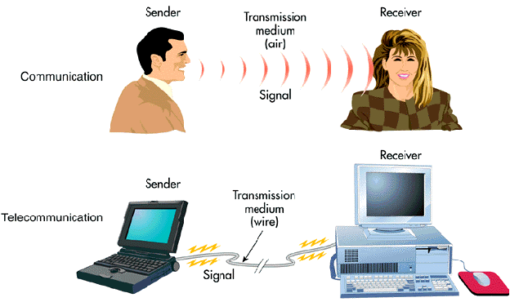

Slide 37
DATA COMMUNICATION
Data Communication is the exchange of data (in the form of O’s and 1’s) between two devices via some form of transmission medium (such as a wire cable).
For data communication to occur, the communicating devices must be of a communication system made up of combination of hardware (Physical component) and software (programs).
37

Slide 38
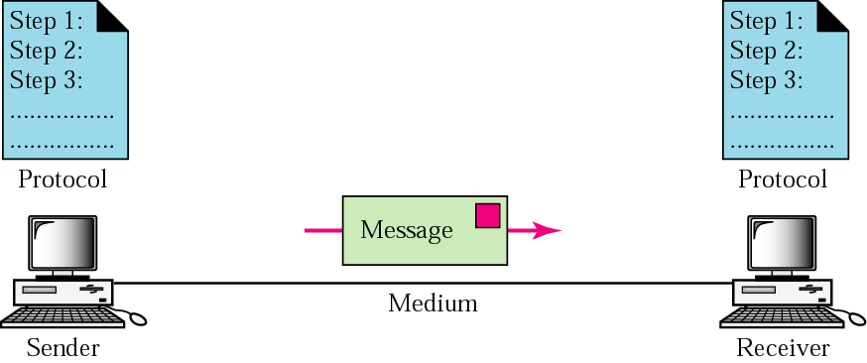
Data Communications

Slide 39
Effectiveness of Data Communication
Depends on four fundamental characteristics
Delivery : The system must deliver data to the correct destination . Data must be received by the intended device or user and only by that device or user.
Accuracy: The system must deliver data to the correct destination . Data that have been altered in transmission and left uncorrected are unusable.
39

Slide 40
Effectiveness of Data Communication
Timeliness: The system must deliver data in a timely manner. (video and audio). This kind of delivery is called real-time transmission.
Jitter : refers to the variation in the packet arrival time. Uneven delay in the delivery of audio and video packet.
40

Slide 41
Five components of data communication
Message : information(data) to be communicated
Sender : The sender is the device that sends the data message. It can be a computer, work station, etc.
Receiver: device that receive the message.
Transmission medium: the physical path by which a message travels from the sender to the receiver e.g. : twisted-pair wire, coaxial cable, fibre-optic cable and radio waves.
Protocol: set of rules that govern data communications. It represents an agreement between the communicating devices. Without a protocol, two devices may be connected but not communicating.
41

Slide 42
DATA COMMUNICATION
The public switched telephone network (PSTN) is used to carry both voice and data communication.
The public switched telephone network started as an analog network designed to handle analog voice signals but it has gradually been converted from an analog to a digital network.
42

Slide 43
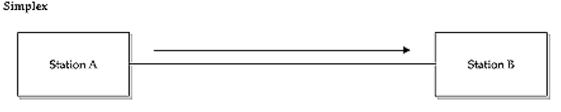
DATA FLOW
Communication between two devices can be simplex, half duplex or full duplex
Simplex : communication is unidirectional, only one of the two devices on a link can transmit; the other can only receive. Keyboards and traditional monitors are example, keyboard can only introduce input; monitor can only accept output.
43

Slide 44
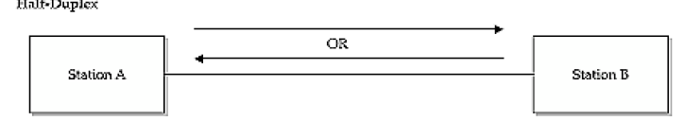
DATA FLOW
Half duplex: each station can both transmit and receive, but not at the same time. When one device is sending, the other can only receive and vice versa.
44

Slide 45
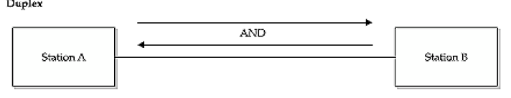
DATA FLOW
Communication between two devices can be simplex, half duplex or full duplex
Full duplex : both stations can transmit and receive simultaneously e.g. when two people are communicating by a telephone line, both can talk and listen at the same time.
45

